Slide 1


University of Basrah
Al-Zahraa Medical College
Ministry of higher Education and Scientific Research
Academic year 2022-2023
5th year
REPRODUCTIVE BLOCK
Lecture
Duration : 20 min
Intrauterine growth restriction or fetal growth restriction)
Presented by
Dr. ABD ALKAREEM HUSSEIN SUBBER
Block staff:
Dr.Marwa Sadik (module leader)
Dr. Abdal kareem Hussain Subber
Dr.Alaa Hufdhi
References: Obstetrics by ten Teacher 20th edition;,
Self Assessment & Review obstetrics edd by SAKSHI ARORA HANS and Internet

Slide 2

University of Basrah
Al-Zahraa Medical College
Ministry of higher Education and Scientific Research
LEARNING OBJECTIVES
To know the definition and types of IUGR
Review the risk factors and causes of Intrauterine Fetal Growth Restriction
Describe methods of diagnosis of IUGR
Outline management of IUGR

Slide 3


University of Basrah
Al-Zahraa Medical College
Ministry of higher Education and Scientific Research
DEFINISION
Intrauterine growth restriction (IUGR) or intrauterine fetal growth retardation ( IUGR) or fetal growth restriction (FGR) refers to a condition in which a fetus or neonate birth weight is below the tenth percentile of the average for the gestational age because of a pathologic process.
Small-for-gestational age for a fetus in utero is an estimated fetal weight that measures < 10th percentile on ultrasound . It is not a pathological.
Growth restriction can occur in preterm, term or post-term babies
IUGR is a leading cause of stillbirth, neonatal mortality, and short- and long-term morbidity

Slide 4
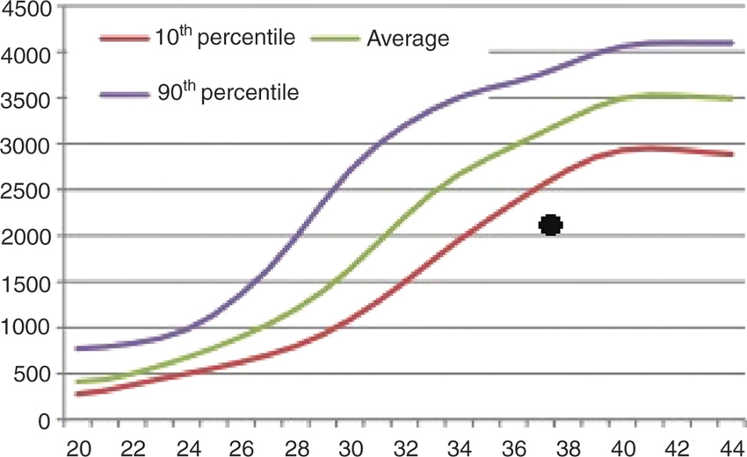
University of Basrah
Al-Zahraa Medical College
Ministry of higher Education and Scientific Research
Weight in gram
Gestational age in weeks

Slide 5
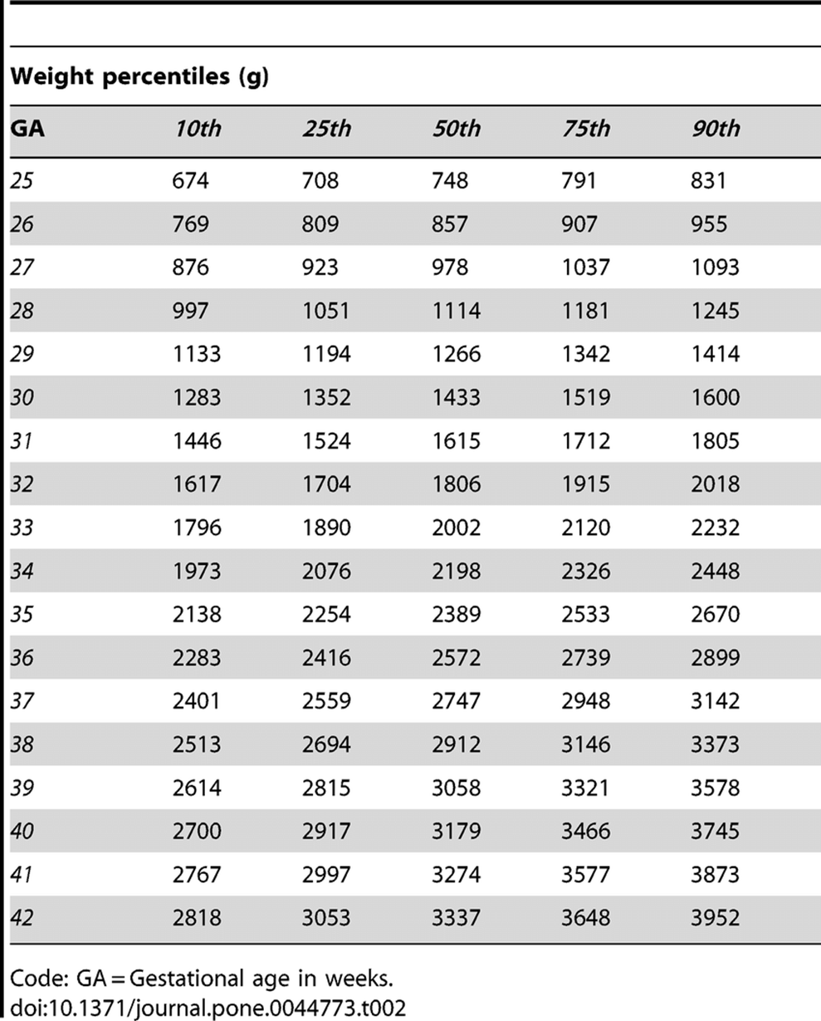
University of Basrah
Al-Zahraa Medical College
Ministry of higher Education and Scientific Research

Slide 6

University of Basrah
Al-Zahraa Medical College
Ministry of higher Education and Scientific Research
TYPES OF IUGR
Depending upon the size of their head, abdomen and femur, the fetuses are subdivided into: (a) Symmetrical or Type I (b) Asymmetrical or Type II.
Symmetrical (20%): The fetus is affected from a harmful effect very early in pregnancy in the phase of cellular hyperplasia. The total cell number is less. It occurs when all parts of the fetus are equally small.
All parts of the fetus (height, weight, and head circumference) are equally affected
This form of growth retardation is most often caused by structural or chromosomal abnormalities or congenital infection (TORCH). The pathological process is intrinsic to the fetus and involves all the organs including the head.
The term TORCH complex or TORCHes infection includes toxoplasmosis, rubella, cytomegalovirus, herpes simplex and others (syphilis, hepatitis B).

Slide 7
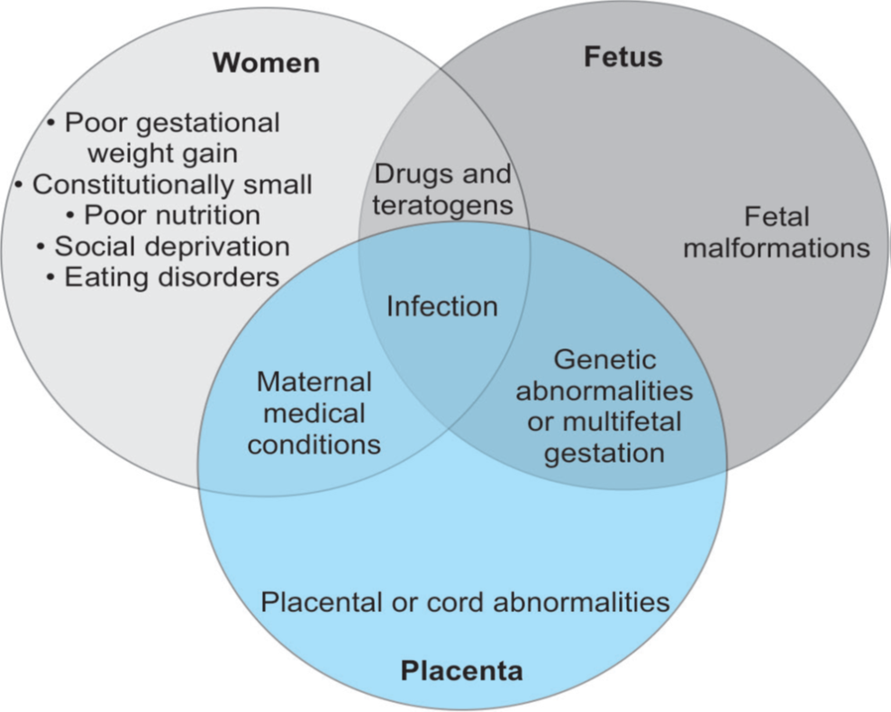
University of Basrah
Al-Zahraa Medical College
Ministry of higher Education and Scientific Research
Causes of IUGR type I

Slide 8
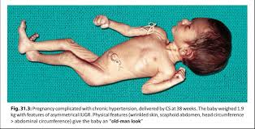
University of Basrah
Al-Zahraa Medical College
Ministry of higher Education and Scientific Research
Asymmetrical (80%)
The fetus is affected in later months of pregnancy during the phase of cellular hypertrophy.
The total cell number remains the same but size is smaller than normal.
The fetus has a normal size head and a small body.
The pathological processes that result in asymmetric growth retardation are maternal diseases extrinsic to the fetus.
These diseases alter the fetal size by reducing utero-placental blood flow or by restricting the oxygen and nutrient transfer or by reducing the placental size.

Slide 9

University of Basrah
Al-Zahraa Medical College
Ministry of higher Education and Scientific Research
Ponderal Index (PI) is an indication of a person's weight relative to their height, and is used as a measure of adiposity . PI is calculated as weight (gm ) divided by cubed height (cm3) multiply by 100
Infant/Child Ponderal Index = 100 x Weight (grams) / Height3 (cm)

Slide 10

University of Basrah
Al-Zahraa Medical College
Ministry of higher Education and Scientific Research
CAUSES OF IUGR
1- Maternal
Constitutional: Small mothers, BMIof <20 are at higher risk IUGR
Poor maternal nutrition during pregnancy, malabsorption
Maternal diseases like Chronic hypertension/PIH; thyroid disorders; Thrombophilia; APL syndrome Hemoglobinopathy; Heart disease Class III and IV; Chronic renal disease Diabetes with vascular lesion
Toxins: Alcohol, Smoking; Heroin, Cocain
Drugs ; Chemotherapeutic agents; Warfarin and Phenytoin
Structural anomalies : Cardiovascular ; Renal ; Osteogenesis imperfect
Chromosomal abnormalities : Trisomy 13 (Patau syndrome), 18 (Edwards syndrome) , 21(Down syndrome ) ; Turner syndrome
Infections (fetal infection) : Toxoplasmosis; syphilis Rubella, CMV, Herpes ; Herpes simplex virus, Varicella virus, and HIV; Malaria
Multiple pregnancy
2-Fetal
3 -Placental
poor uterine blood flow to the placental site for long time ( placental insufficiency ), Placenta praevia ; Abruption; ; Infarction; Placental hemangiomas ; single umbilical artery; Chronic villitis

Slide 11

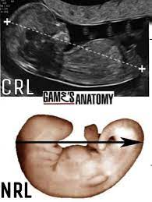
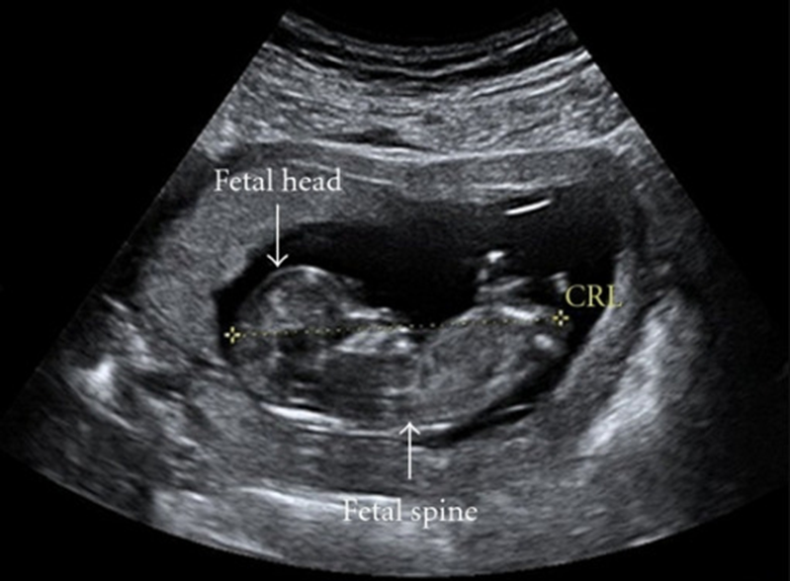
University of Basrah
Al-Zahraa Medical College
Ministry of higher Education and Scientific Research
CLINICAL PRESENTATION
• Often asymptomatic
Decrease fetal movement and poor abdominal enlargement
•May present with symptoms of the underlying etiology, such as hypertension or diabetes
1- Dating
Accurate knowledge of gestational age is vital to avoid incorrect diagnosis.
Dating by LMP is valuable if menstrual cycles are regular.
Crown-rump length (CRL) measured by U/S between 7 and 10 wks of gestation is the most accurate way to date a pregnancy (± 3 days.

Slide 12
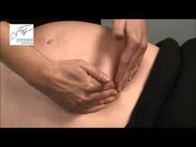
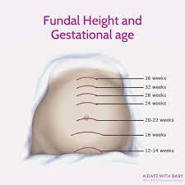
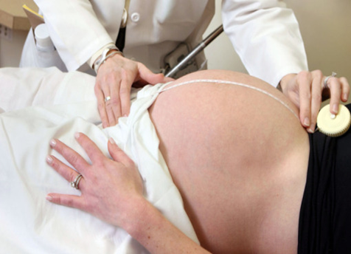
University of Basrah
Al-Zahraa Medical College
Ministry of higher Education and Scientific Research
2- History and physical examination:
Maternal weight gain: It is an insensitive index of fetal growth
Fundal height: Uterine fundal height: Measurement of the uterine fundal height is the most common method used to clinically estimate fetal growth.
Symphysiofundal height (SFH):
@ Measured in centimeters between 24 and 37 weeks
@ FGR: ≥ 3 cm less than the expected height for gestational age

Slide 13
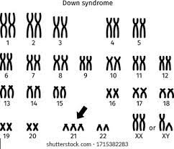
University of Basrah
Al-Zahraa Medical College
Ministry of higher Education and Scientific Research
3-Screening for maternal conditions
Hypertension screening
Thyroid function testing
HbA1c to screen for diabetes
4-Screen for fetal condition
Infection
((Congenital TORCH infections: group of infections acquired in utero, including toxoplasmosis, syphilis, varicella-zoster virus, parvovirus B19, HIV, rubella, cytomegalovirus, and herpes simplex.
These diseases can have significant consequences, such as FGR, preterm birth, congenital abnormalities, or fetal death))
Aneuploidy a fetus is having missing or extra chromosomes

Slide 14
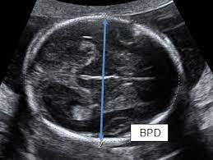
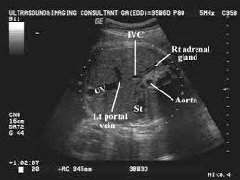
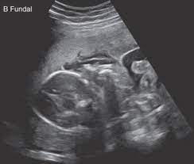
University of Basrah
Al-Zahraa Medical College
Ministry of higher Education and Scientific Research
5 –Ultrasonography
Serial measurement of Biparietal diameter (BPD) aid in diagnose IUGR
Serial measurements of Abdominal circumference ( AC) and estimations of fetal weight are more diagnostic to fetal growth restriction
Fetal weight estimates are usually within 5–10% of the true fetal weight.
Head to abdomen ratio (HC/AC): In asymmetric IUGR, HC is ↑, HC/AC > 1. In symmetric IUGR, both HC and AC are decreased. So HC/AC remains normal
Oligohydramnios (low amniotic fluid )
Doppler velocimetry ( Most Important): Abnormal umbilical artery Doppler velocimetry findings—characterized by absent or reversed end diastolic flow—have been uniquely linked with IUGR. It has also been correlated with hypoxia, acidosis and fetal death.

Slide 15
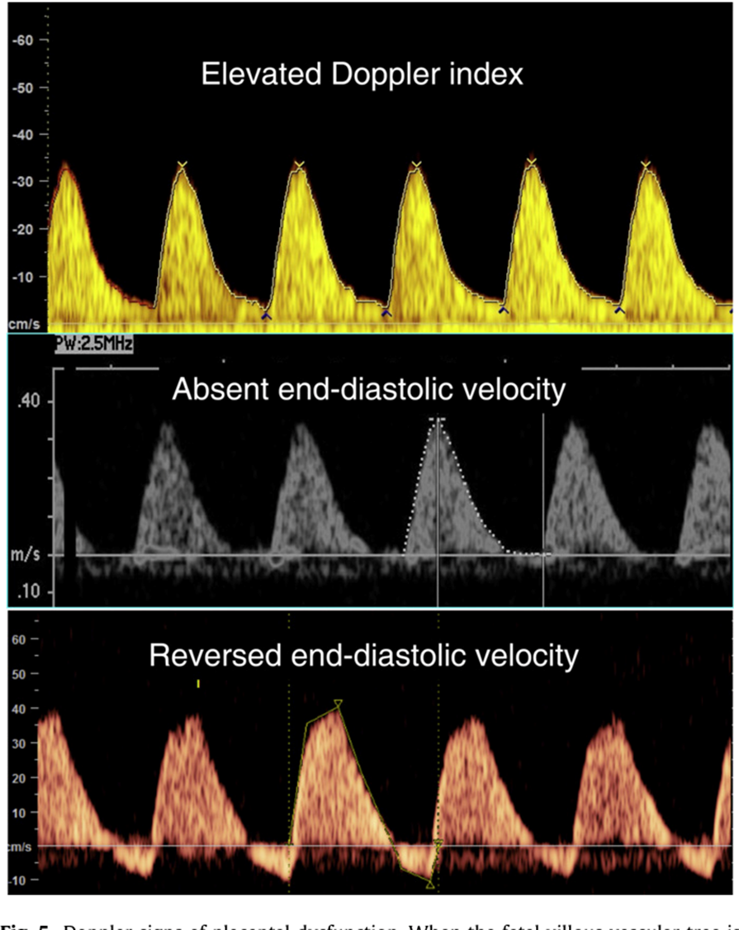
University of Basrah
Al-Zahraa Medical College
Ministry of higher Education and Scientific Research

Slide 16


University of Basrah
Al-Zahraa Medical College
Ministry of higher Education and Scientific Research
COMPLICATIONS
Fetal
(a) Antenatal—Chronic fetal distress, fetal death
(b) Intranatal—Hypoxia and acidosis
(c) After birth.: Immediate: (1) Asphyxia, and RDS. (2) Hypoglycemia
(3) Meconium aspiration syndrome (4) DIC. (5) Hypothermia. (6) Pulmonary hemorrhage. (7) Polycythemia, anemia, thrombocytopenia. (8) Hyperviscosity-thrombosis. (9) Necrotizing enterocolitis (10) Intraventricular hemorrhage (IVH). (11) Electrolyte abnormalities: hypocalcemia, hyperphosphatemia, hypokalemia due to impaired renal function. (12) Multiorgan failure. (13) Increased perinatal morbidity and mortality.
: Late: Spastic cerebral palsy ; Neurodevelopmental abnormalities
Asymmetrical IUGR babies tend to catch up growth in early infancy. The fetuses are likely to have: (1) retarded neurological and intellectual development in infancy. The worst prognosis is for IUGR caused by congenital infection, congenital abnormalities and chromosomal defects.

Slide 17

University of Basrah
Al-Zahraa Medical College
Ministry of higher Education and Scientific Research
General approach
Management starts with adequate treatment of the underlying cause, if identified, such as:
Diabetes ;
Hypertension ;
Autoimmune conditions
Lifestyle modifications ( stop smoking , increase BMI in very thin patient

Slide 18

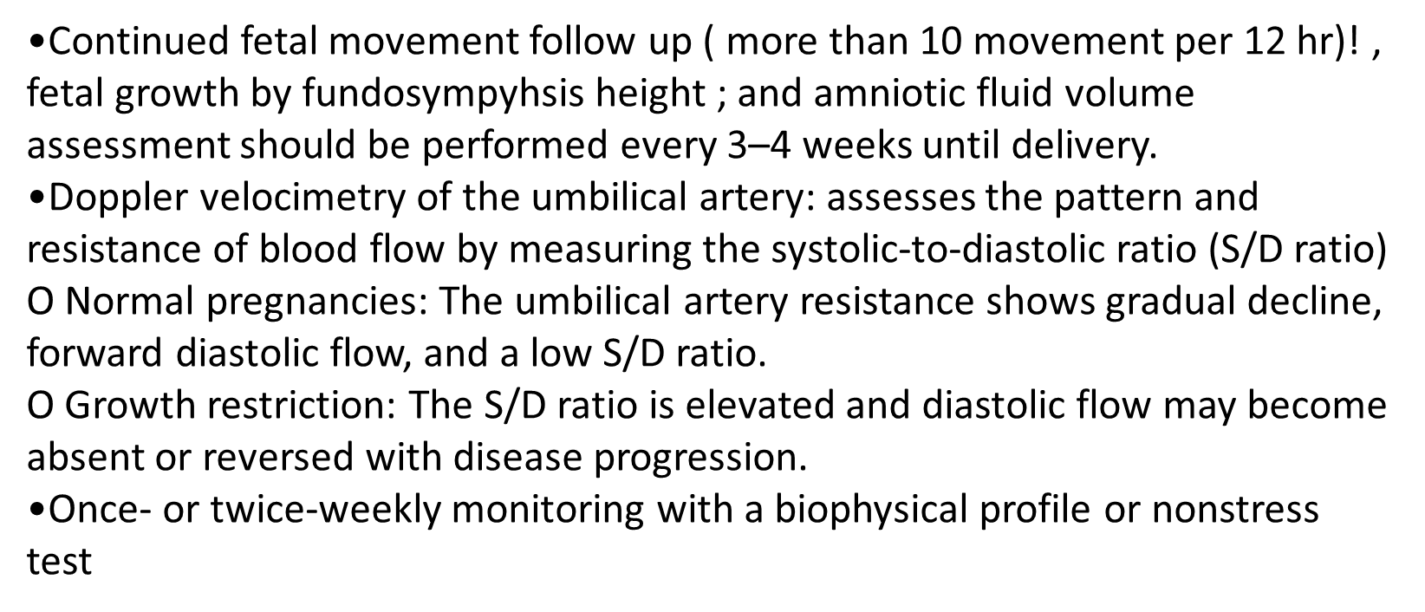
University of Basrah
Al-Zahraa Medical College
Ministry of higher Education and Scientific Research

Slide 19
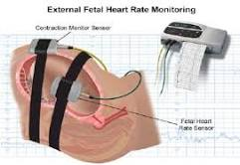
University of Basrah
Al-Zahraa Medical College
Ministry of higher Education and Scientific Research
A nonstress test (NST)
A cardiotocograph is used to monitor the fetal heart rate and presence or absence of uterine contractions. The test is typically termed "reactive" (also "reassuring") or "nonreactive“.
Reactive" is defined as the presence of two or more fetal heart rate accelerations within a 20-minute period. Each acceleration must increase the heart rate 15 beats per minute above the baseline rate,
Non-reactive" is defined as fewer than two adequate accelerations during a prolonged period.
biophysical profile
It measures by ultrasound after 28 wke of gestation ,body movement, muscle tone, breathing movement and amniotic fluid volume around the fetus

Slide 20
University of Basrah
Al-Zahraa Medical College
Ministry of higher Education and Scientific Research
Delivery
•Timing of delivery should be individualized.
•If severe IUGR before 24 wks , option between termination of pregnancy and expectant management with repeat ultrasound every 3- 4 wks
• If pregnancy > 24 but < 34 wks , evaluate maternal and fetal condition, consider corticosteroid to improve lung maturity, follow up by Doppler ultrasound and Non Stress Test ( NST), Biophysical profile ((It measures body movement, muscle tone, breathing movement and amniotic fluid volume around the fetus)) ; consider delivery if bad changes occurred.
• If > 34 wks, follow up maternal condition, Doppler ultrasound and Non Stress Test ( NST), Biophysical profile; consider delivery if bad changes
• Consider termination of pregnancy if IUGR discovered after 38 wks of gestation

